Slide 1
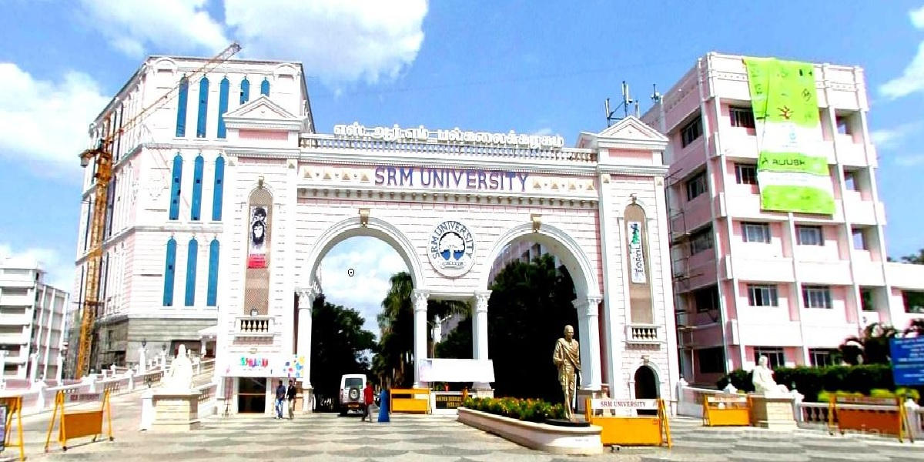

SRM Institute Of Science And Technology
PRESENTATION
Pixel Harbour
using Image Enhancement Algorithms
NAME :- GAURAV GUPTA
BRANCH :- Btech CSE specialization
(AI & ML)
DEPATMENT :- CINTEL
SUBJECT :- Digital Image Processing
REG. NO. :- 2211026010284

Slide 2
Pixel Harbour

Slide 3

Content
introduction
Background
Motivation
Proposed methodology
Datasets
Results and analysis
References

Slide 4
Introduction

Slide 5
Introduction
In the realm of digital image processing, "Pixel Harbor" emerges as a comprehensive solution, providing users with a unified platform to execute diverse image operations seamlessly. This user-friendly GUI application consolidates various image processing techniques, eliminating the need for users to navigate different tools for specific operations.

Slide 6
Background

Slide 7
Background
Digital image processing involves the manipulation of images using mathematical and computational techniques. Historically, users faced challenges accessing disparate tools or platforms for specific image operations. "Pixel Harbor" addresses this inconvenience by integrating a range of operations into a single, cohesive environment, leveraging the capabilities of Python and associated libraries.

Slide 8
Motivation

Slide 9
Motivation
Motivated by the desire to streamline image processing workflows, "Pixel Harbor" enhances user experience, reduces the learning curve associated with multiple tools, and promotes efficiency in image manipulation tasks. This project caters to both novice and experienced users, fostering a more accessible and versatile image processing environment.

Slide 10
Operations performed

Slide 11
Operations performed
*Conversion to Grayscale* :
*Edge Detection* :
*Image Enhancement* :
*Image Smoothing* :
*Contrast Adjustment* :
*Denoising Image* :
*Deblur Image* :
*Histogram Equalization* :
*Image Sharpening* :

Slide 12
Operations performed
*Conversion to Grayscale* :
Algorithm: The conversion to grayscale typically involves transforming the color image (usually in RGB format) into shades of gray, representing the luminance of the original colors. A common formula for this conversion is Y' = 0.299R + 0.587G + 0.114B, where R, G, and B are the red, green, and blue channel values respectively.

Slide 13
Operations performed
* Edge Detection * :
Algorithm: Edge detection in PIL through ImageFilter.FIND_EDGES is likely based on common edge detection algorithms such as the Sobel, Prewitt, or Roberts Cross operator, which compute the gradient of the image intensity to find regions with high spatial derivatives. The specific algorithm used is not explicitly documented, but these methods are typical.

Slide 14
Operations performed
* Enhance Image* :
Algorithm: Image enhancement in these functions is performed through contrast adjustment, likely by altering the image's histogram or applying a linear or non-linear transformation to increase the difference between dark and light areas of the image. The exact mathematical operation isn't specified in the PIL documentation, but it generally aims to improve image clarity and detail.

Slide 15
Operations performed
* Smooth Image* :
Algorithm: Smoothing (or blurring) in PIL with ImageFilter.SMOOTH likely uses a simple average (mean) filter or a similar low-pass filtering technique, which reduces the image noise and details by averaging the pixels with their neighbors.

Slide 16
Operations performed
* Denoise Image* :
Algorithm: OpenCV's cv2.fastNlMeansDenoisingColored uses the Non-local Means Denoising algorithm, which works by comparing all patches in the image and averaging similar ones. This method is effective in removing noise while preserving edges.

Slide 17
Operations performed
* Deblur Image* :
Algorithm: The Gaussian Blur used in cv2.GaussianBlur applies a Gaussian filter to blur the image. This operation reduces image noise and detail by giving more weight to pixels around the center of the kernel and less to those further away, based on the Gaussian function.

Slide 18
Operations performed
* Histogram Equalization* :
Algorithm: cv2.equalizeHist applies histogram equalization, which improves the contrast in an image by stretching the range of intensities. This is done by effectively spreading out the most frequent intensity values, making the image easier to analyze.

Slide 19
Operations performed
* Deblur Image Enhanced* :
Algorithm: The enhanced deblurring method combines a Gaussian blur with the original image using cv2.addWeighted to adjust contrast and brightness. This technique can simulate the effect of removing blur and adjusting clarity by blending a blurred version with the original based on specified weights.

Slide 20
Operations performed
* Sharpen Image Enhanced* :
Algorithm: The enhanced sharpening uses a convolution with a custom sharpening kernel defined by sharpen_kernel. This kernel is designed to enhance edges by increasing the contrast between neighboring pixels. The use of a custom kernel allows for more aggressive sharpening than what might be achieved with predefined filters.

Slide 21
Archtiecture for image processing

Slide 22
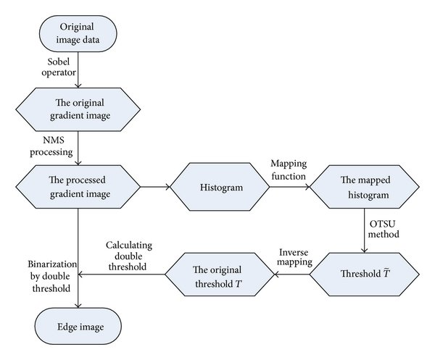
Edge detection

Slide 23
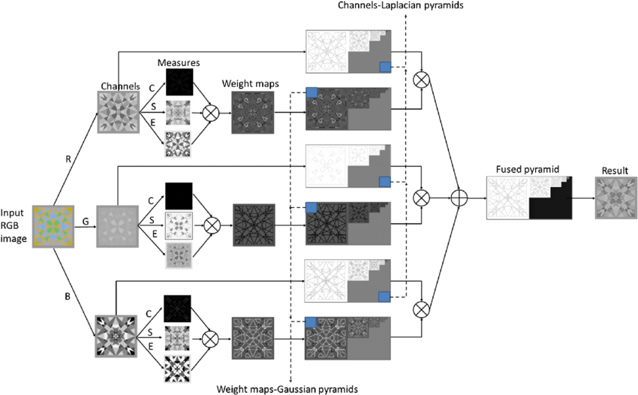
Grayscale conversion

Slide 24
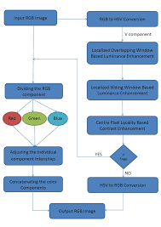
Image enhancement

Slide 25
Proposed methodology

Slide 26
Proposed methodology
*User Interface Design:*
Description of the graphical user interface (GUI) design using Tkinter or any other relevant library.
Explanation of how users interact with the application, including selecting an image and choosing an image processing operation.

Slide 27
Proposed methodology
*Operations Module:*
Details about the organization and structure of the operations.py file, which contains functions for various image processing operations.
Explanation of the modularity and encapsulation principles applied to ensure maintainability and flexibility.

Slide 28
Proposed methodology
*User Input and Decision Tree:*
Discussion on how the application handles user input and uses a decision tree or a switch-case mechanism to determine the chosen image processing operation.
Clarification on how the decision-making process flows based on user choices.

Slide 29
Proposed methodology
*Output Handling and Saving:*
Explanation of how the processed image is presented to the user on the GUI.
Description of the method used to prompt the user for a directory to save the processed image.
Details on how the output path is constructed and the processed image is saved.

Slide 30
Proposed methodology
*Error Handling and User Feedback:*
Overview of the error handling mechanisms in place to provide informative messages to the user in case of invalid input or processing errors.
Explanation of how the application ensures a smooth user experience by offering clear feedback.

Slide 31
Proposed methodology
*Extensibility and Future Enhancements:*
Discussion on how the modular architecture allows for the easy addition of new image processing operations.
Considerations for future enhancements, such as integrating machine learning algorithms, real-time processing, or support for additional image formats.

Slide 32
Datasets

Slide 33
Datasets
"Pixel Harbor" does not specifically rely on predefined datasets. Users can apply the implemented operations to images from any source, including personal photographs, publicly available datasets, or other image repositories.

Slide 34
Results

Slide 35
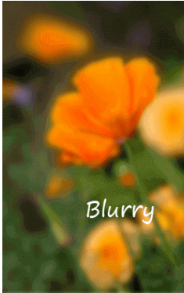
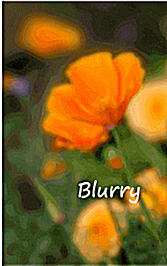
deblur

Slide 36
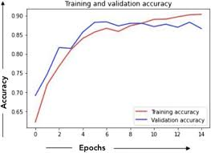
deblur

Slide 37
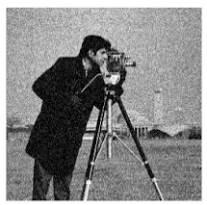
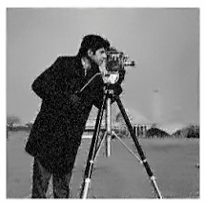
Denoising

Slide 38
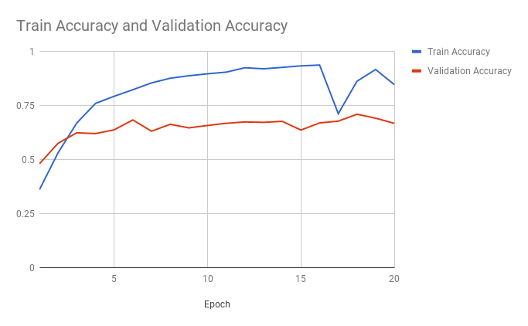
denoise

Slide 39
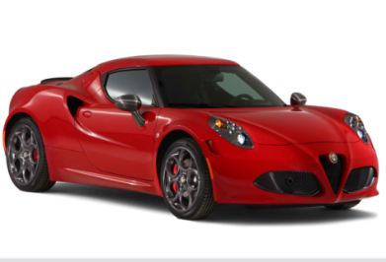
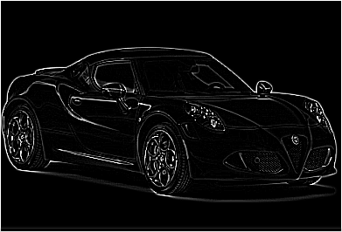
Edge detection

Slide 40
Edge detection

Slide 41
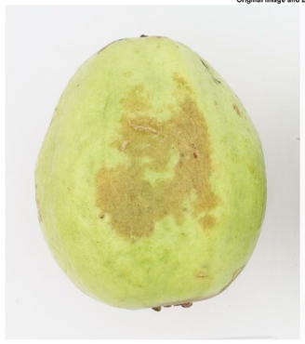

Image enhancement

Slide 42
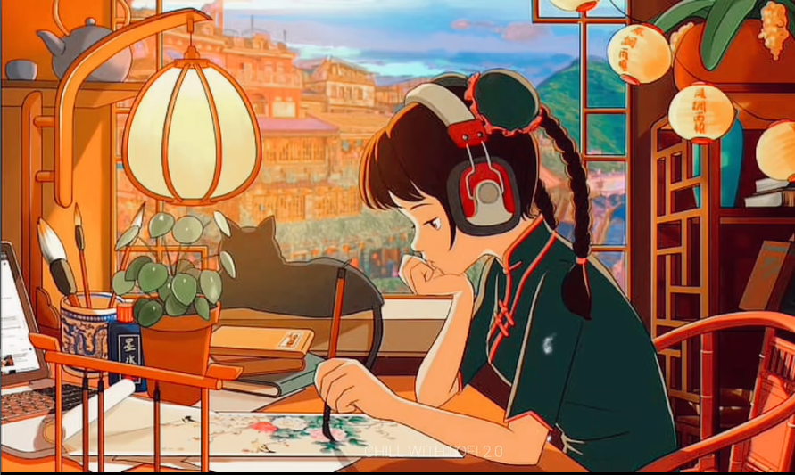
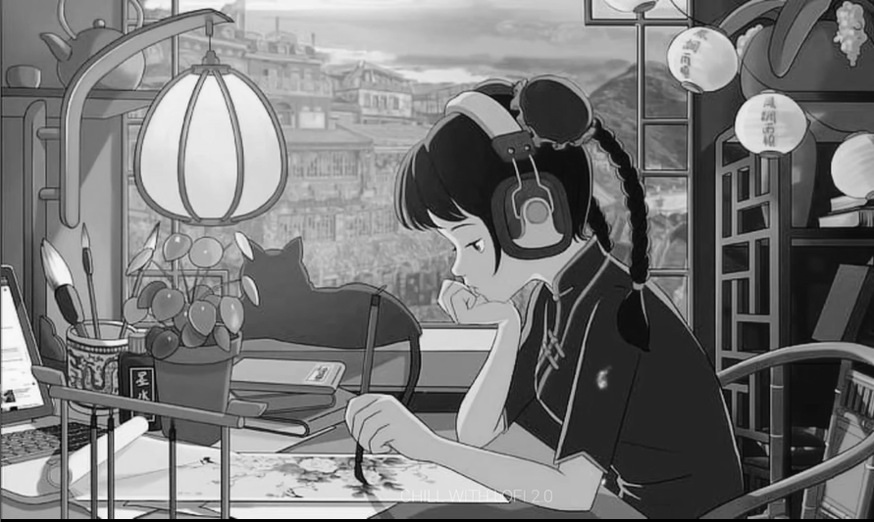
Grayscale conversion

Slide 43
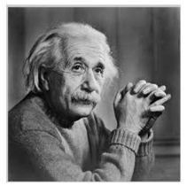
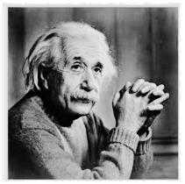
Histogram equilization

Slide 44
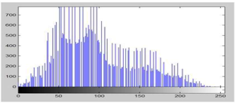
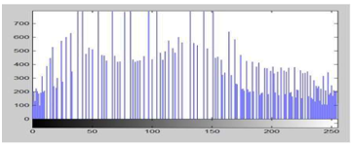
Histogram equilization

Slide 45
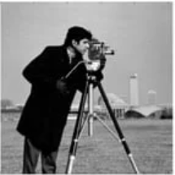

Image smoothing

Slide 46
conclusion

Slide 47
conclusion
In conclusion, "Pixel Harbor" excels as an intuitive image processing tool, integrating diverse operations within a user-friendly interface. Its modular design ensures flexibility, facilitating easy additions and modifications to the processing repertoire. Effective error handling enhances user experience, providing clear feedback. Streamlining workflows and offering adaptability, the project meets dynamic demands in digital image processing. "Pixel Harbor" stands as a testament to the power of integration, providing both efficiency and accessibility, promising advancements in the realm of unified image manipulation tools.

Slide 48
Refrences

Slide 49
References
*Tkinter Documentation.* https://docs.python.org/3/library/tkinter.html
*OpenCV Documentation.* https://docs.opencv.org/4.x/index.html
*PIL (Pillow) Documentation.* https://pillow.readthedocs.io/en/stable/
*Super-Resolution Convolutional Neural Network (SRCNN)* https://arxiv.org/abs/1501.00092
*Image Enhancement using Deconvolution* https://www.researchgate.net/publication/220970995_Image_enhancement_using_deconvolution

